Slide 1
Component-Based Development

Slide 2
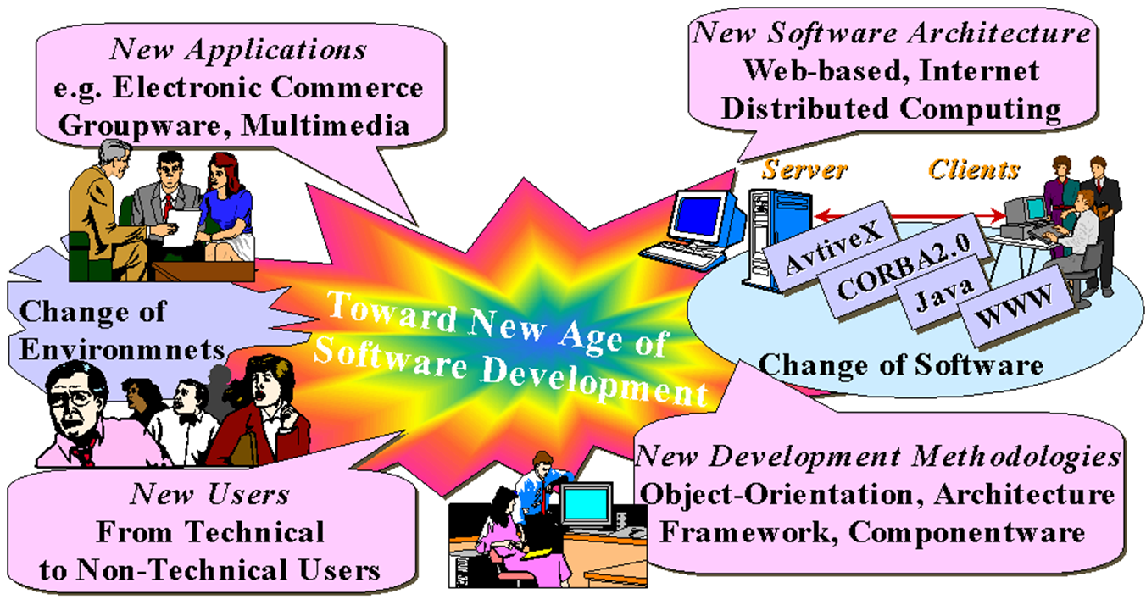
Component-Based Development

Slide 3
Component Based Development
Component-based software engineering (CBSE) is a software system development methodology where the system is developed using reusable software components.
Component-based development aims at improved efficiency, performance and quality of the system by recycling components.

Slide 4
Component-based software engineering (CBSE)
Component Based Software Engineering (CBSE) is changing the way software systems are developed.
CBSE embodies the ‘buy, don’t build’ philosophy…CBSE shifts the emphasis from programming software to composing software systems.

Slide 5
Component-based software engineering
Component
Component is a functional unit of a system and its functionality is defined by its interfaces.
A component contains a set of collaborating classes.
A component contains processing logic, the internal data structures required to implement the processing logic, and an interface.

Slide 6
The main characteristics of the components
Components general do something useful,
A small related set of functions or services,
Real OO programs are component based,
Classes are not components,
Components are composable,
Independent − Components are designed to have minimal dependencies on other components.

Slide 7
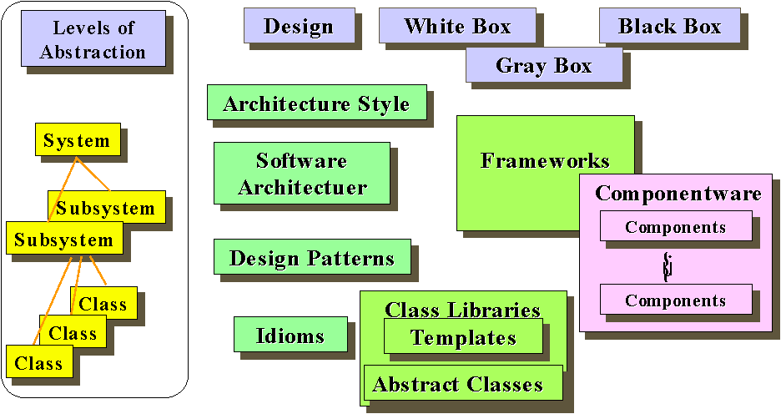
Elements of Software Reuse

Slide 8
CBSE Approach
Plug & Play: The component should be able to plug and play with other components and/or frameworks so that component can be composed at run-time without compilation.
Interface-centric: The component should separate the interface from the implementation and hide the implementation details so that they can be composed without knowing their implementation.
Architecture-centric: Components are designed on a pre-defined architecture so that they can interoperate with other components and/or frameworks.

Slide 9
CBSE Approach (cont’d)
Standardization: The component interface should be standardized so that it can be manufactured by multiple vendors and widely reused across corporations.
Distribution through Market: Components can be acquired and improved though competition market, and provide incentives to the vendors.

Slide 10
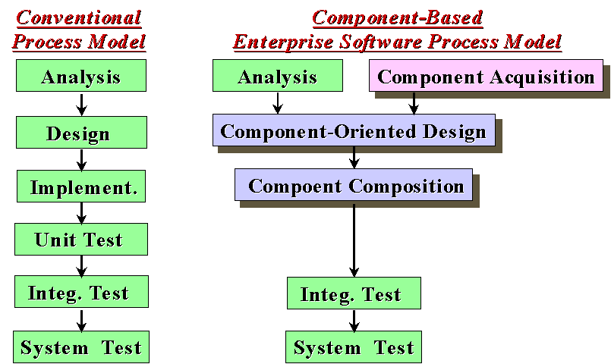
CBSE – The Architecture of Software Process

Slide 11
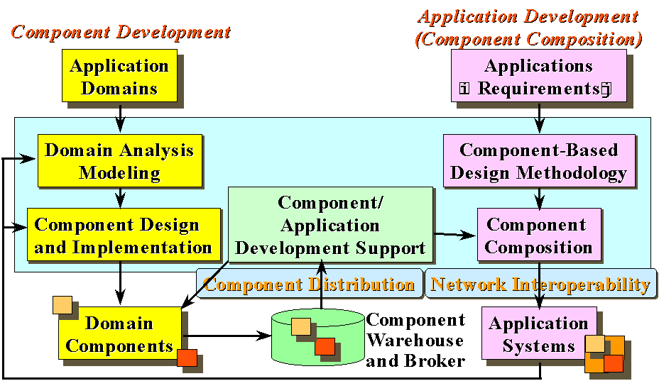
Methodology

Slide 12
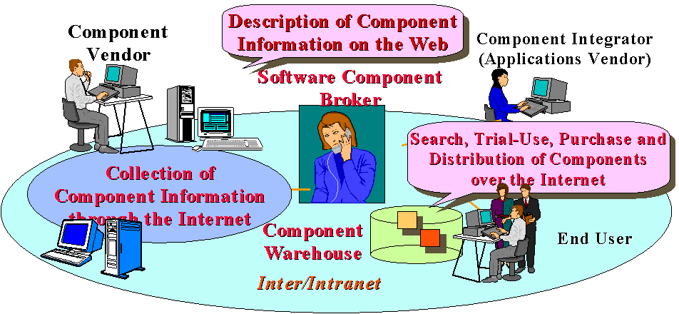
Vendor-Broker-Integrator Model

Slide 13
Examples of component models
EJB model (Enterprise Java Beans)
COM+ model (.NET model)
Common Object Request Broker Architecture (Corba) Component Model

Slide 14
Advantages
Advantages from the business point of view in terms of shorter time-to-market, lower development and maintenance costs.
Advantages from technical and engineering point of view which can be increased understandability of complex systems and increased reusability, interoperability, flexibility, adaptability, and dependability.
A strategic point of view of society such as increasing the software market, and the generation of new companies.

Slide 15
Disadvantages
Time and effort are required for the development of Components.
Unclear and ambiguous requirements.
Conflict between usability and reusability.
Component maintenance costs.
Reliability and sensitivity to changes.

